Slide 1
Projects

Slide 2
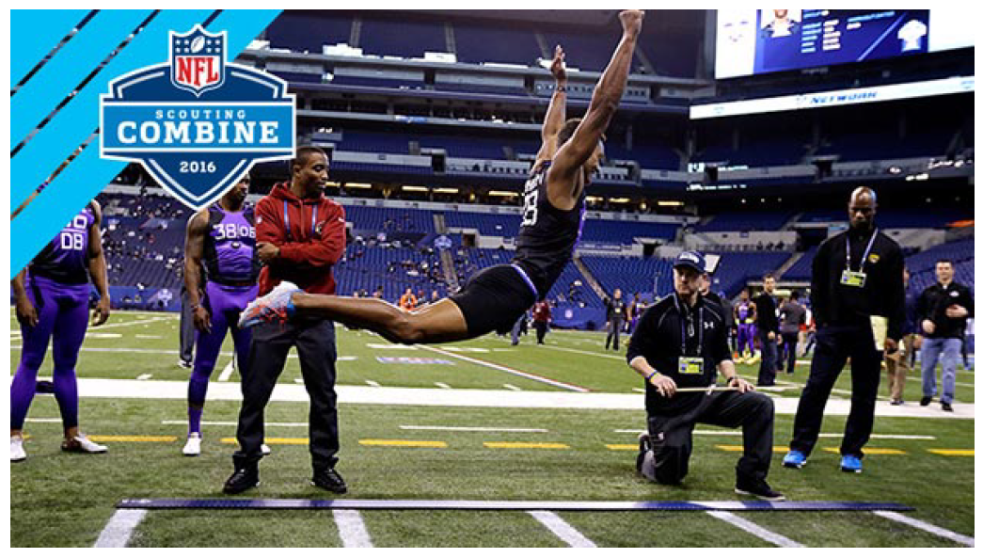

Slide 3
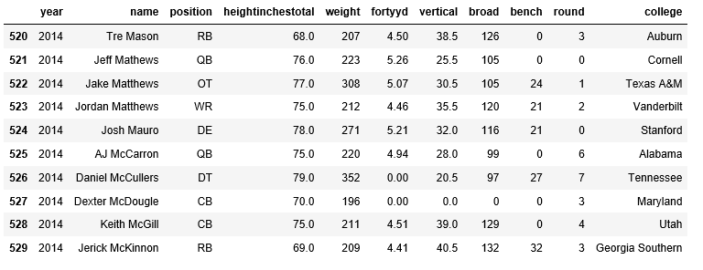

Slide 4
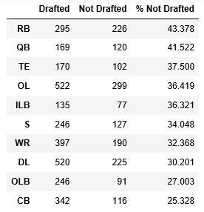

Slide 5
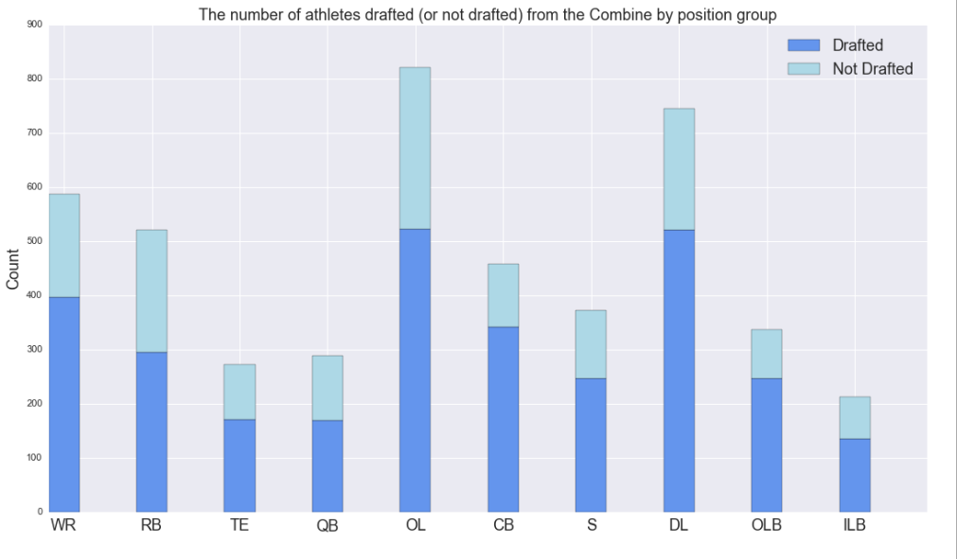

Slide 6
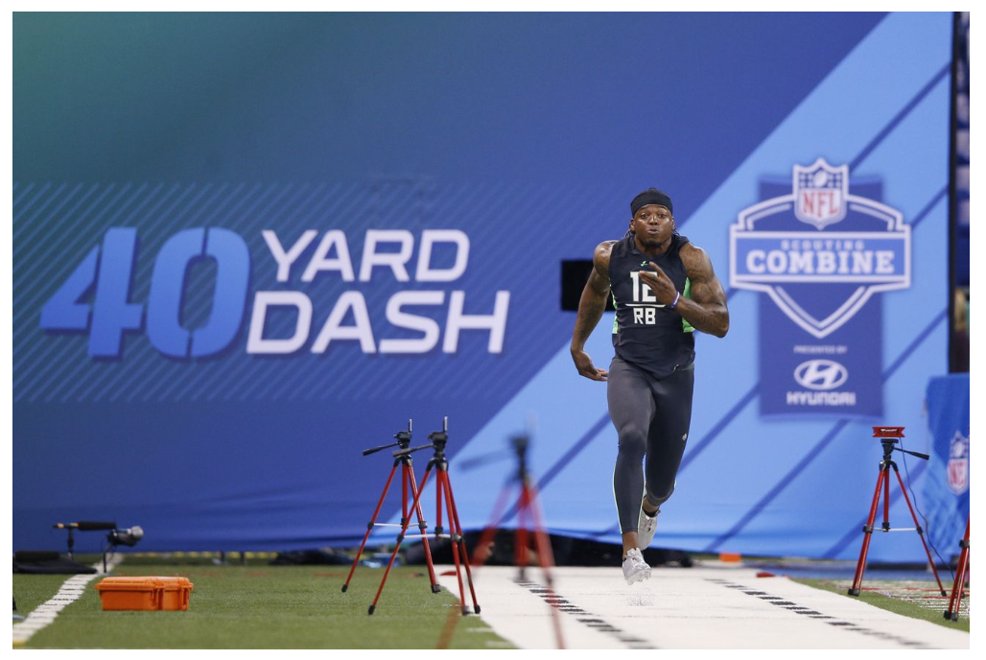

Slide 7
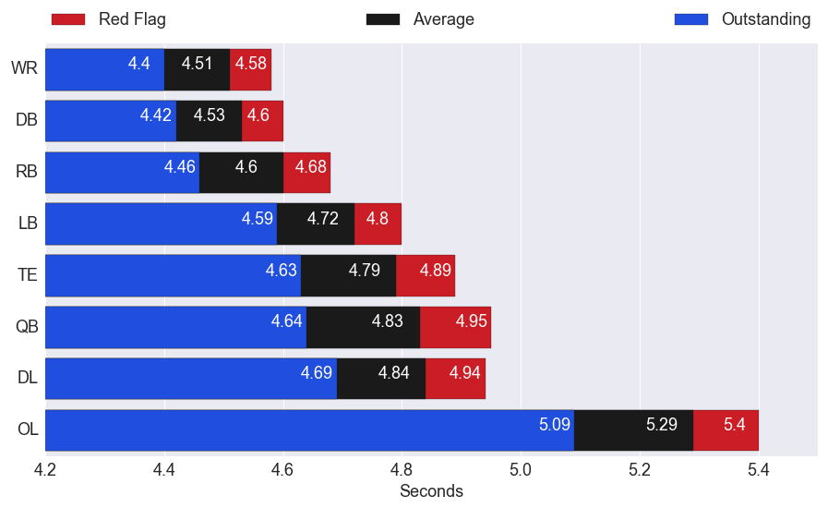

Slide 8
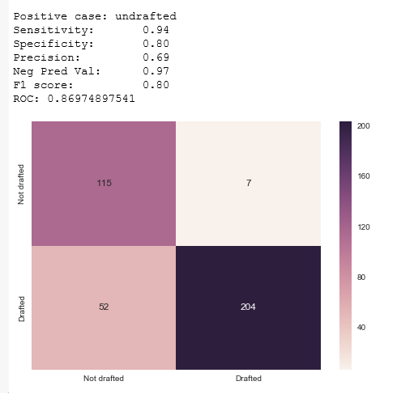

Slide 10
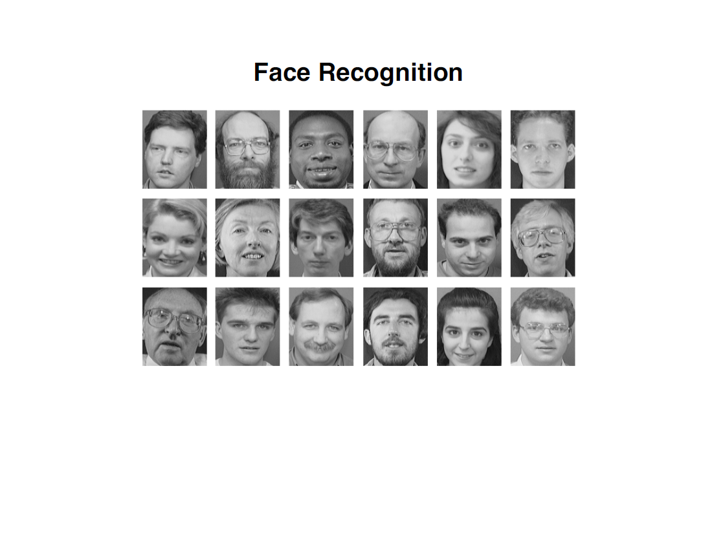

Slide 11
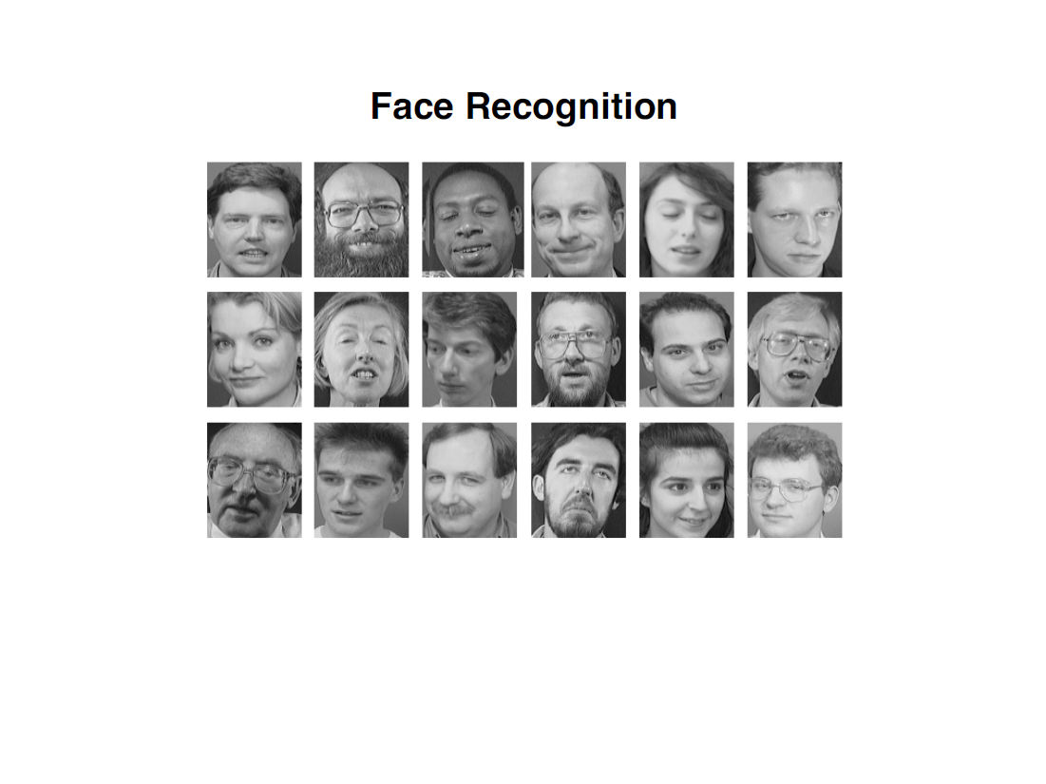

Slide 12
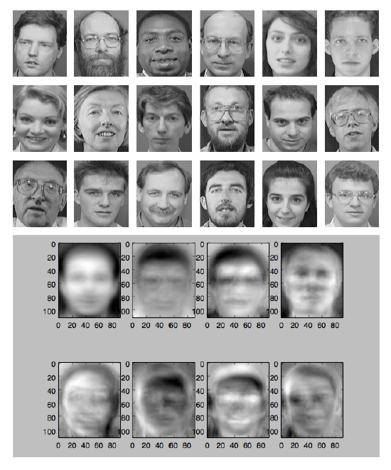

Slide 13
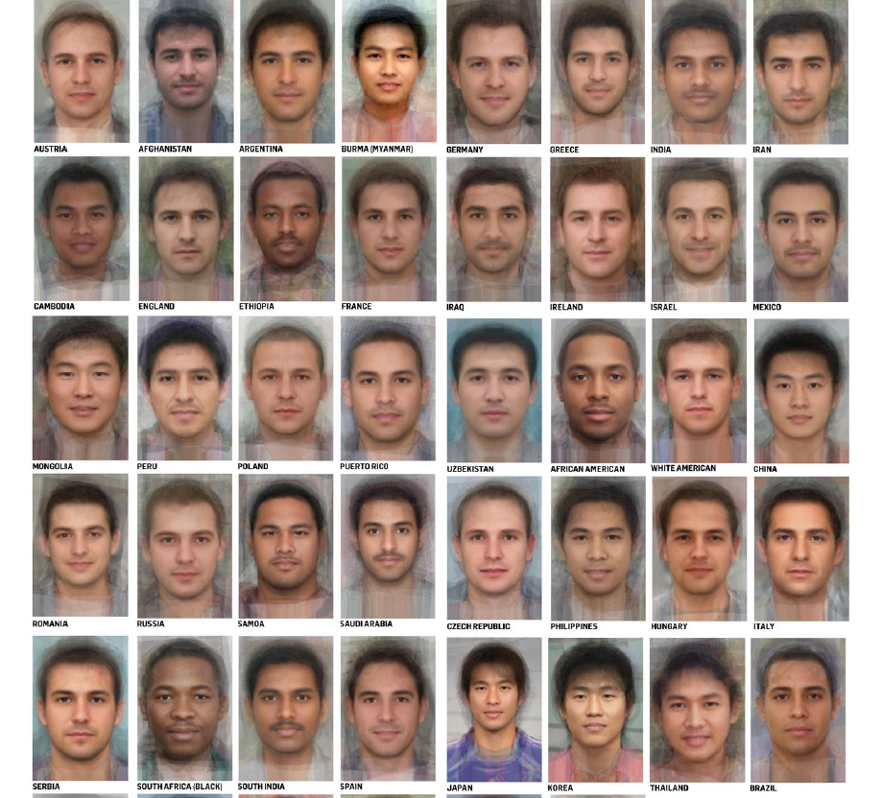

Slide 14
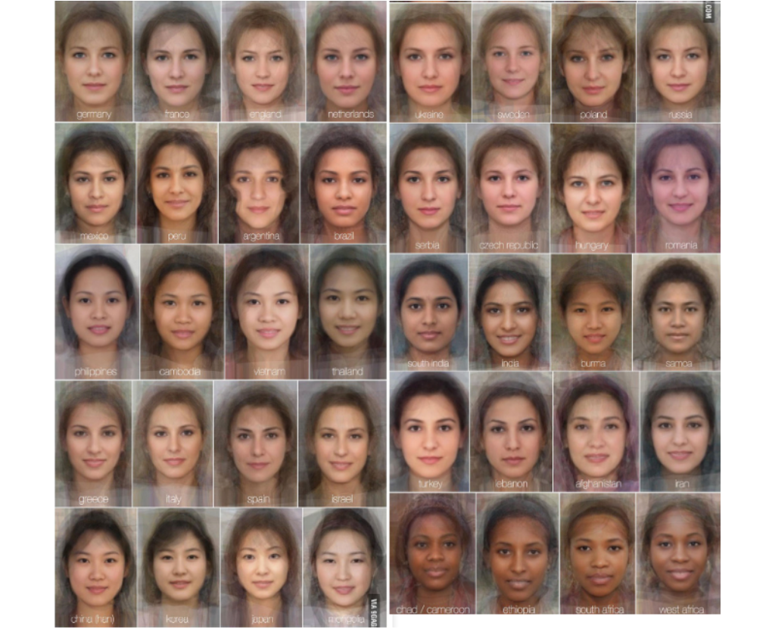

Slide 15
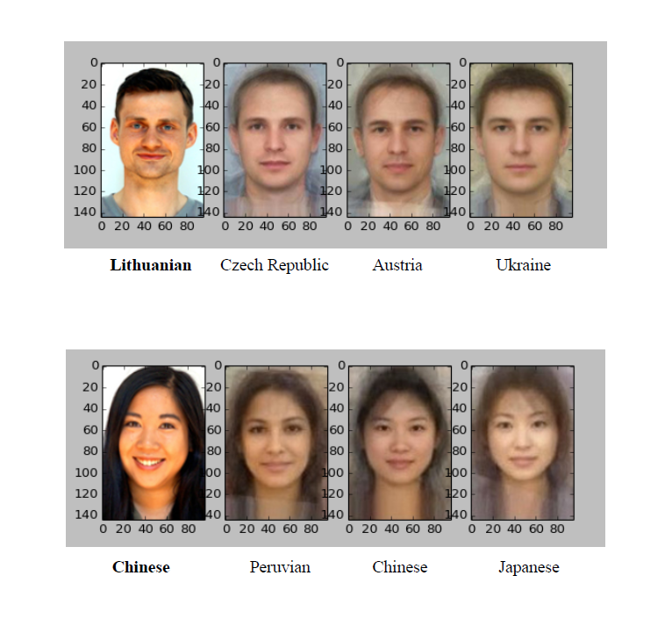

Slide 17
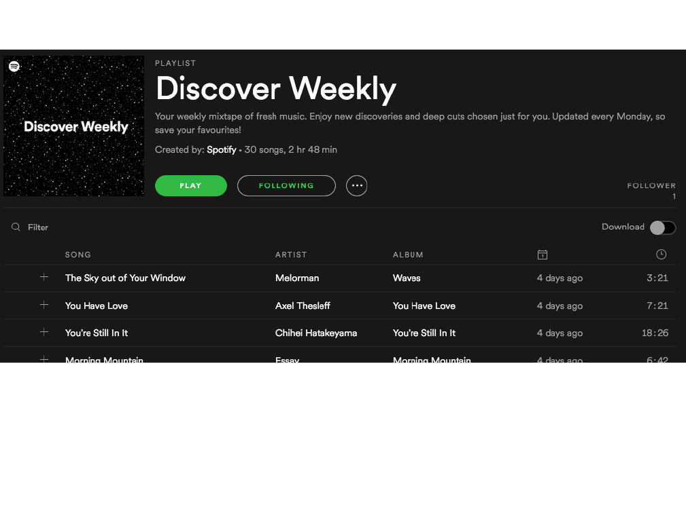

Slide 18
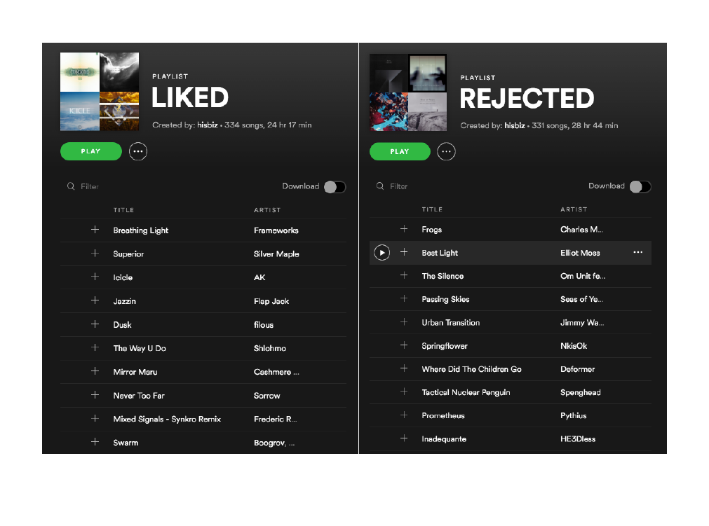

Slide 19


Slide 20
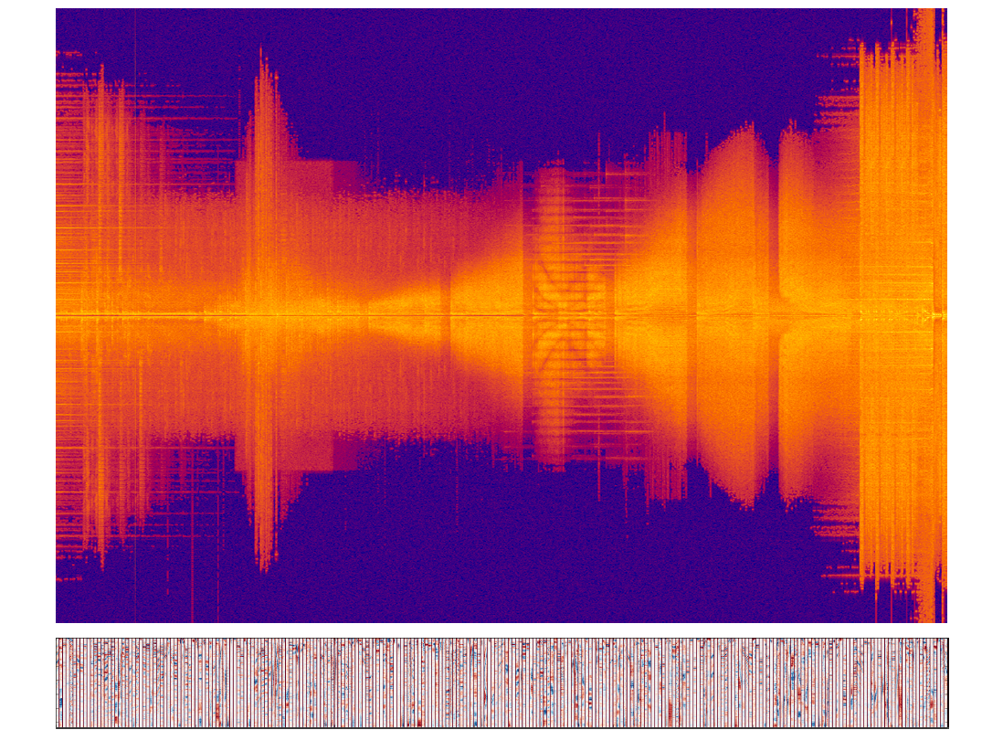

Slide 21
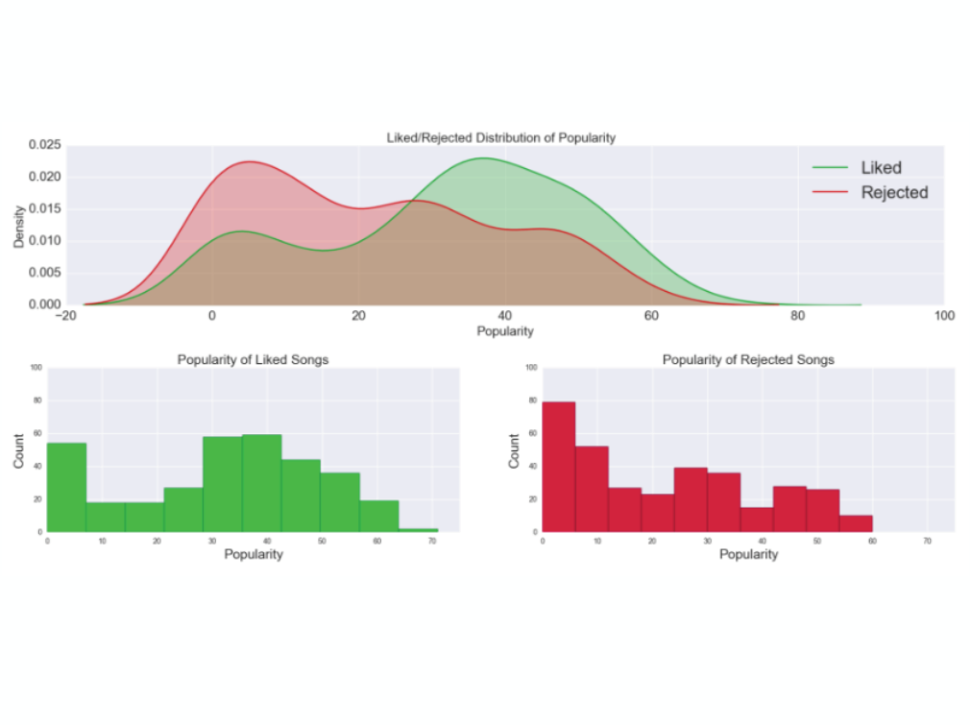

Slide 22
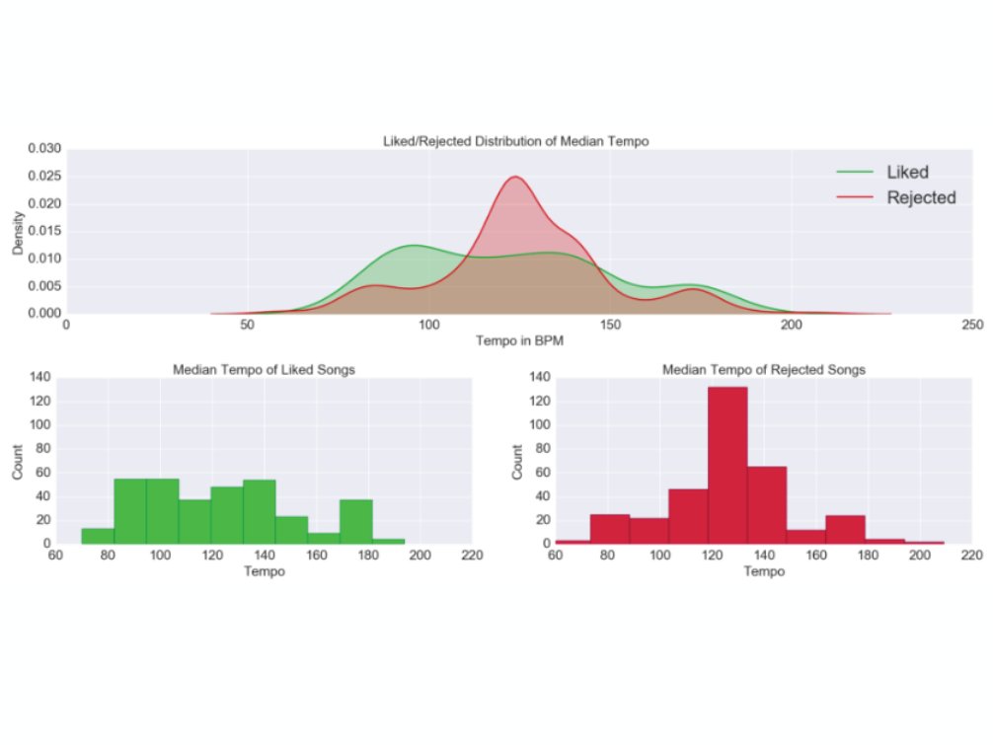

Slide 23
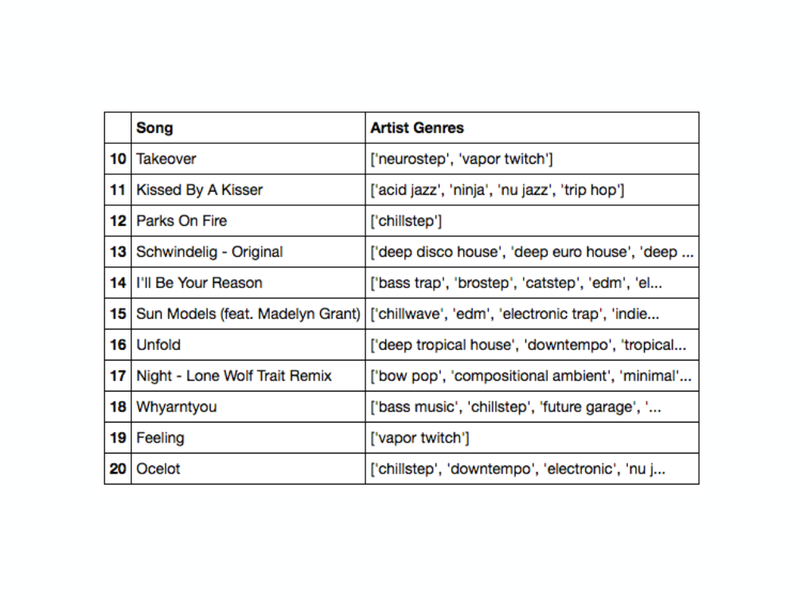

Slide 24
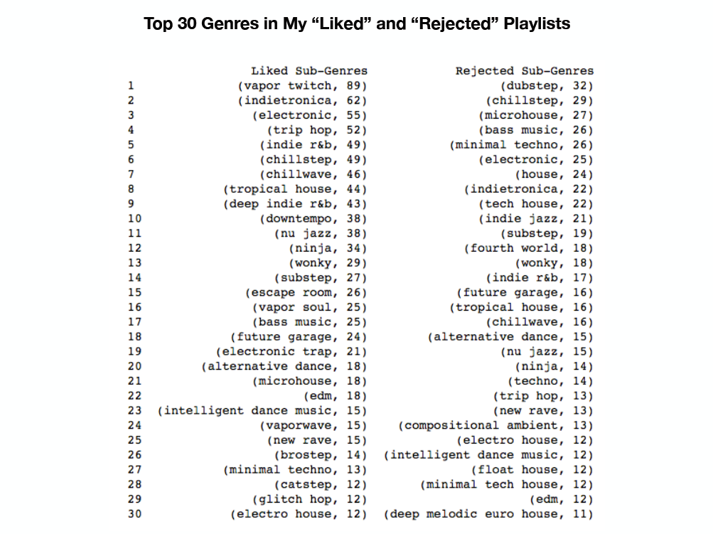

Slide 25
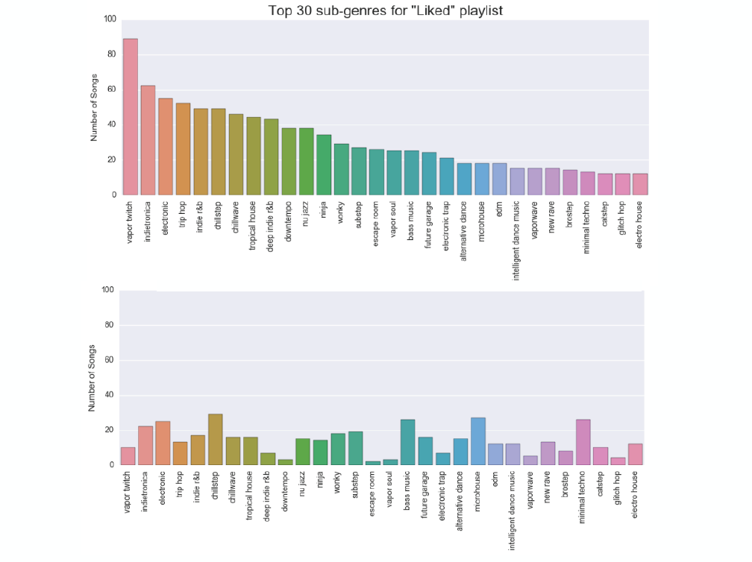

Slide 26















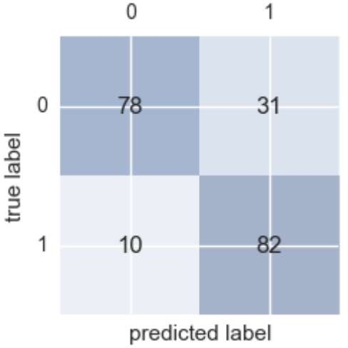

Slide 29
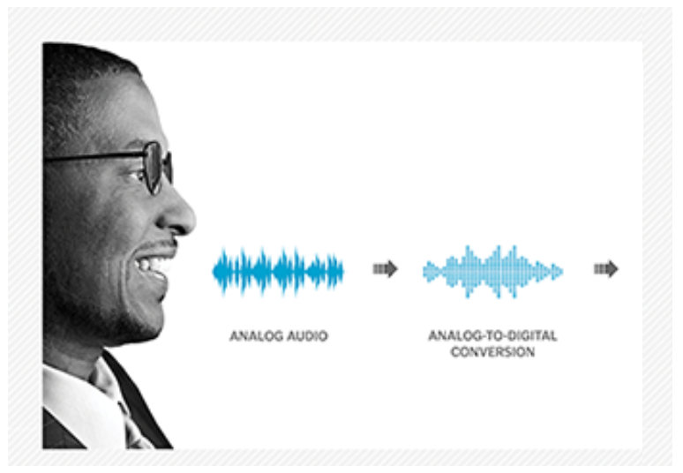
Recognizing Race by Voice

Slide 31

“Apple became the first U.S. company to surpass
$1 trillion in market value.”
- Wall Street Journal, August 2, 2018

Slide 32

Tech companies are amassing wealth and
power, creating a new order in business where the most valuable resource is no longer oil, but
data.
- Wall Street Journal, September 5, 2018

Slide 33
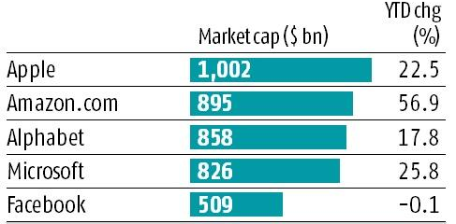
Top 5 Companies in the World

Slide 34
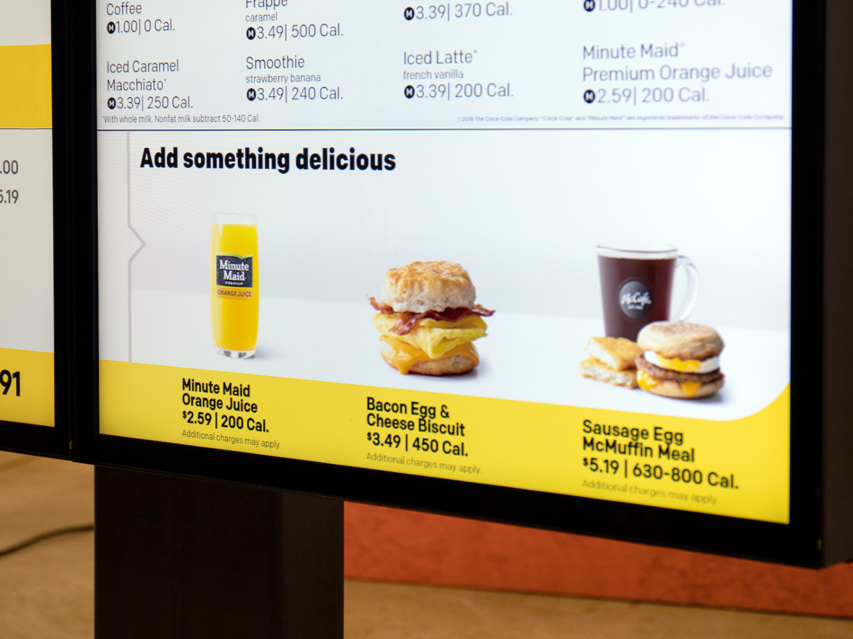
“We’re expanding our ability to increase the role technology and data will play in our future and create more personalized experiences for our customers.”
March 25, 2019
Steve Easterbrook, McDonald’s CEO

Slide 36
Next steps
Make a custom plan for yourself to continue this journey
Improve some of your skills (Stats, Python, ML, Domain, etc.)
Take some additional courses
Try a Kaggle.com competition
Work on a personal project to improve understanding and motivate your learning

Slide 37
Useful Data Science and Machine Learning books for beginners to intermediate:
Book | Author
Data Smart: Using Data Science to Transform Information Into Insight | John W. Foreman
Naked Statistics: Stripping the Dread from the Data | Charles Wheelan
An Introduction to Statistical Learning | Robert Tibshirani and Trevor Hastie
Python Machine Learning | Sebastian Raschka and Vahid Mirjalili
The Hundred-Page Machine Learning Book | Andriy Burkov

